Slide 1
Upscaling Basic Sanitation for the Urban Poor (UBSUP)
DTF Site Selection Decision Matrix

Slide 2
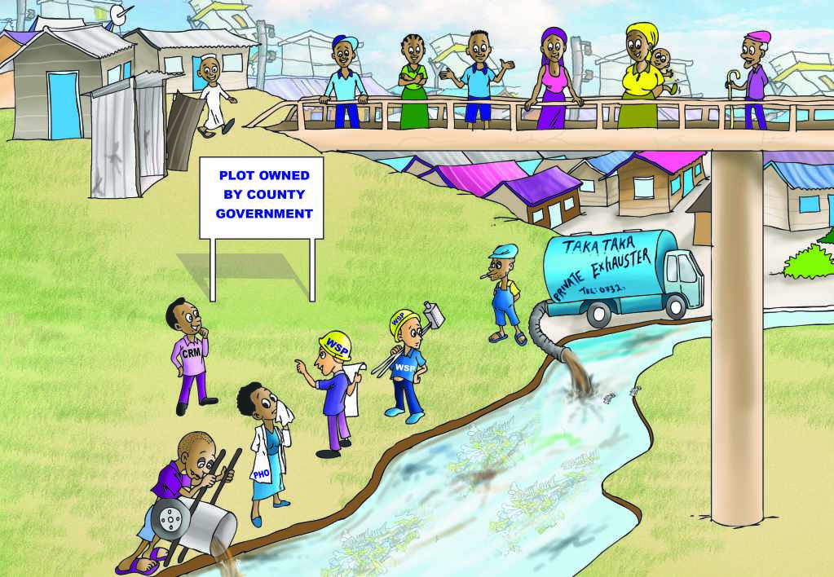
Objective: You are able to identify the correct site for your DTF

Slide 3
Content
Questions you might to ask yourself:
What is the context of this session?
How does this tool works?
May I try it with my colleagues?

Slide 4
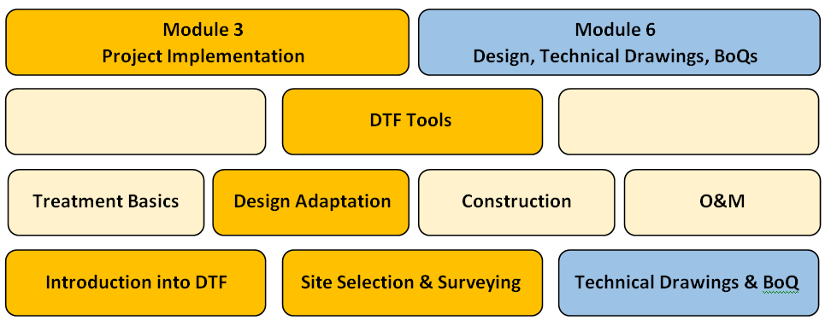
What is the context of this session?
The UBSUP SafiSan Toolkit
all info can be found in your manual

Slide 5
How does this tool work?
Two questionnaires support you to find out:
Matrix 1: Is a site generally suitable?
Matrix 2: Which treatment trains are required:
Treatment of UDDT dried matter (approx. 250 UDDTs) at a co-composting area (CA), and/or
Treatment of FS (approx. 22m³/d) in a RB/BT - ST – ABR – VFCW plus a SDRB

Slide 6
How is matrix 1 filled out?
Colum No: Reference number of guiding question
Column Guiding Question: Questions referring to considerations
Column Yes / No / I don’t know / N/A: Fill in answer on guiding question
Column Comments: Add any clarification you think is required
Columns 4-6 are filled by WSTF staff – not by WSP

Slide 7
How is matrix 2 filled out?
Colum No: Reference number of guiding question
Column Guiding Question: Questions referring to considerations
Column Yes / No / I don’t know: Fill in answer on guiding question
Column Comments: Add any clarification you think is required
Grey colored cells are not to be answered
Columns 5-7 are filled by WSTF staff – not by WSP

Slide 8
How do the matrices look like exactly?

Slide 9
May I try it with my colleagues?
Group Exercise “DTF site check”:
Your company applied for a DTF. Please recall your scenario for 2 minutes
Please fill both decision matrixes for your proposed DTF site with your DTF technical team colleagues and find out (30 minutes)
whether the site is suitable
which treatment trains are required
Please present your results 10 minutes to the plenary
Please ask questions if you are not sure how to fill the matrices

Slide 10
Do you have any questions, remarks or suggestions?

